Slide 1

Using R as a GIS (with a special focus on RQGIS)
Dr. Jannes Münchow
FSU Jena - Department of GIScience
Notes:
Hello everybody, thank you for coming. Today I would like you to introduce to the RQGIS package. It integrates R with QGIS for advanced geocomputing since it combines the best of two worlds. ON the one hand it uses the geoprocessing power of QGIS and on the other hand it uses the statistical and analytical power of R.
First of all, I would like to ask you to download the session material from slack.

Slide 2
Who am I
Vielleicht nicht notwendig, weil ich schon vorgestellt wurde..

Slide 3
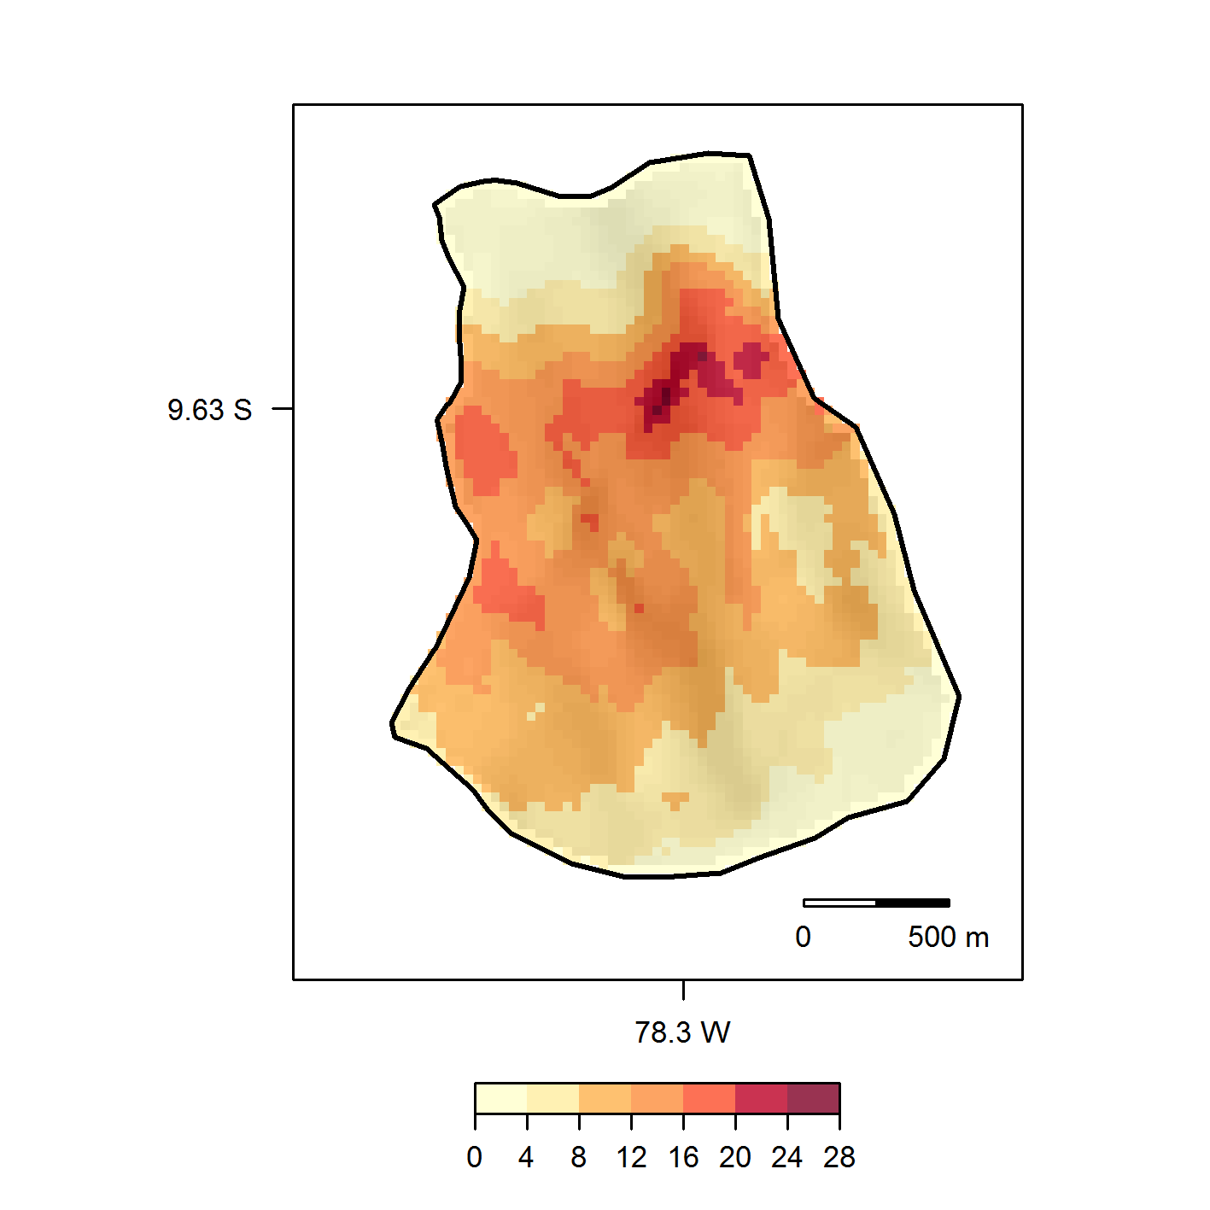
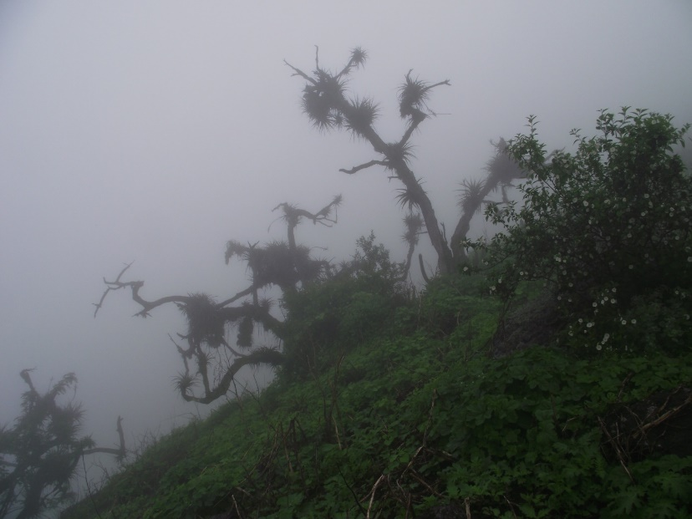
Contents
R as a GIS
Intro to RQGIS
Ecological RQGIS/modeling example
Notes:
2 and 3 include a computer practical

Slide 4

R as a GIS

Slide 5
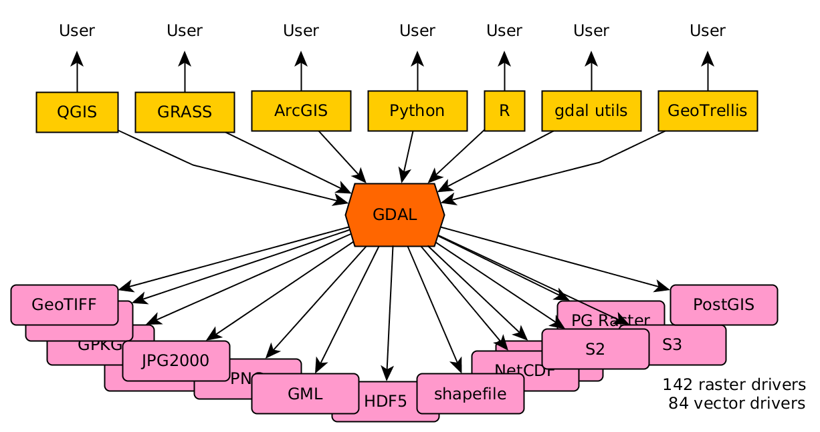
R as a GIS
More than 100 geo-related R packages (https://cran.r-project.org/web/views/Spatial.html)
Package rgdal for importing and exporting geodata
http://r-spatial.org//2016/11/29/openeo.html

Slide 6
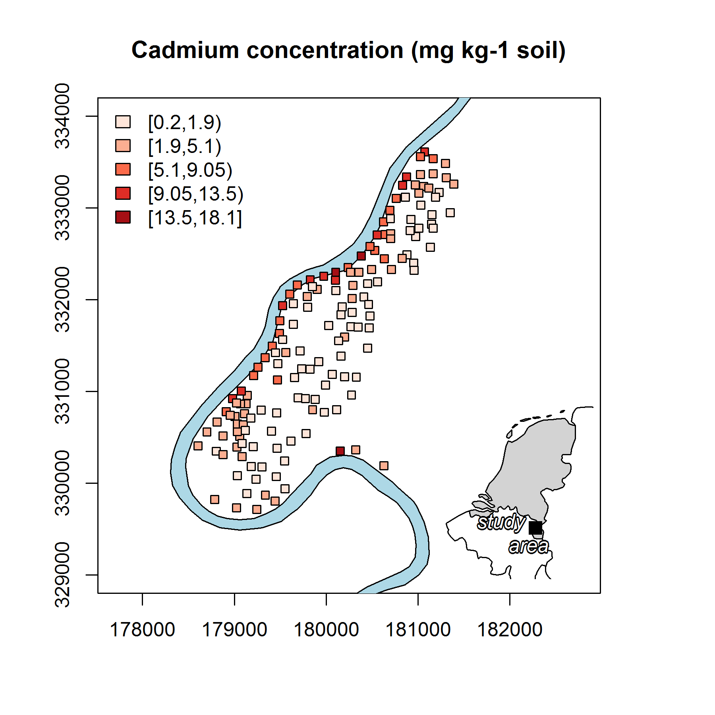
R as a GIS
More than 100 geo-related R packages (https://cran.r-project.org/web/views/Spatial.html)
Package rgdal for importing and exporting geodata
Package sp for vector geodata
Data: Rikken, M.G.J & Van Rijn, R.P.G. (1993).

Slide 7
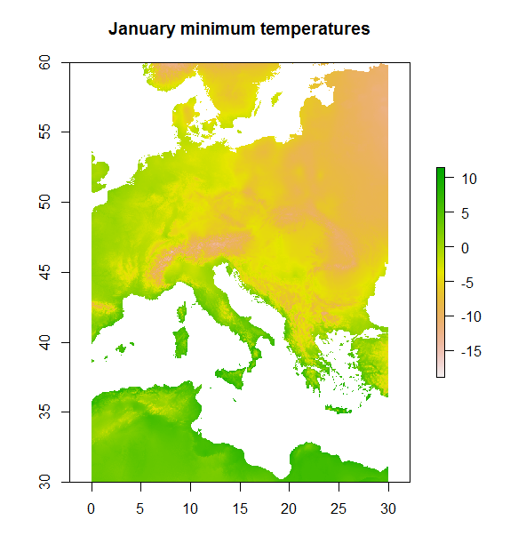
R as a GIS
More than 100 geo-related R packages (https://cran.r-project.org/web/views/Spatial.html)
Package rgdal for importing and exporting geodata
Package sp for vector geodata
Package raster for raster geodata
Data: http://www.worldclim.org/.

Slide 8
R as a GIS
Defining a GIS as a system for the analysis, manipulation and visualization of geographical data (Longley, Goodchild, Maguire, and Rhind 2011), one could argue that R has become a GIS.

Slide 9


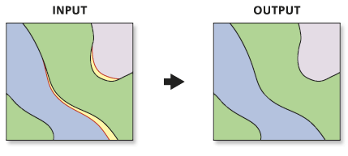
But what about…
http://www.unioneag.org
http://help.arcgis.com/
Notes:
Digitizing
Spatial databases
topology

Slide 10
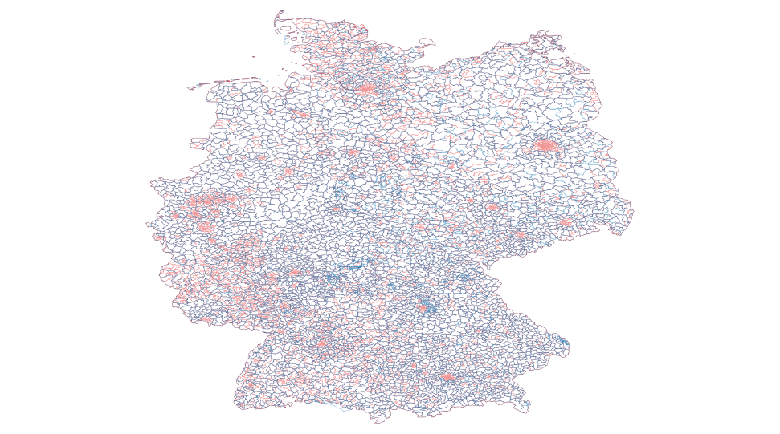
Computationally demanding operations
Computationally demanding operations
Notes:
Union of 20.000 polygons

Slide 11
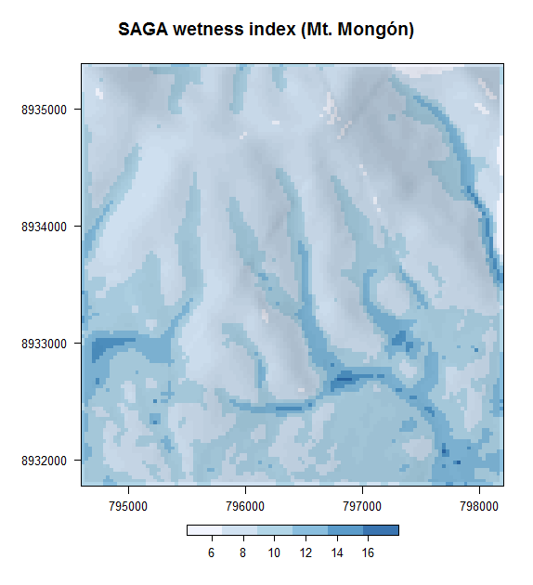
Missing geoalgorithms
Catchment area
Catchment slope
Saga Wetness Index
Lidar processing
…

Slide 12
Interface
R has been designed from the beginning as an interactive interface to other software packages (Chambers, 2016).

Slide 13



R-GIS integration
RSAGA
rgrass7
RPyGeo

Slide 14

What has been missing…
Interface to the most widely used open-source Desktop GIS
Access to QGIS geoalgorithms
QGIS itself integrates GIS power houses
Notable features of RQGIS

Slide 15
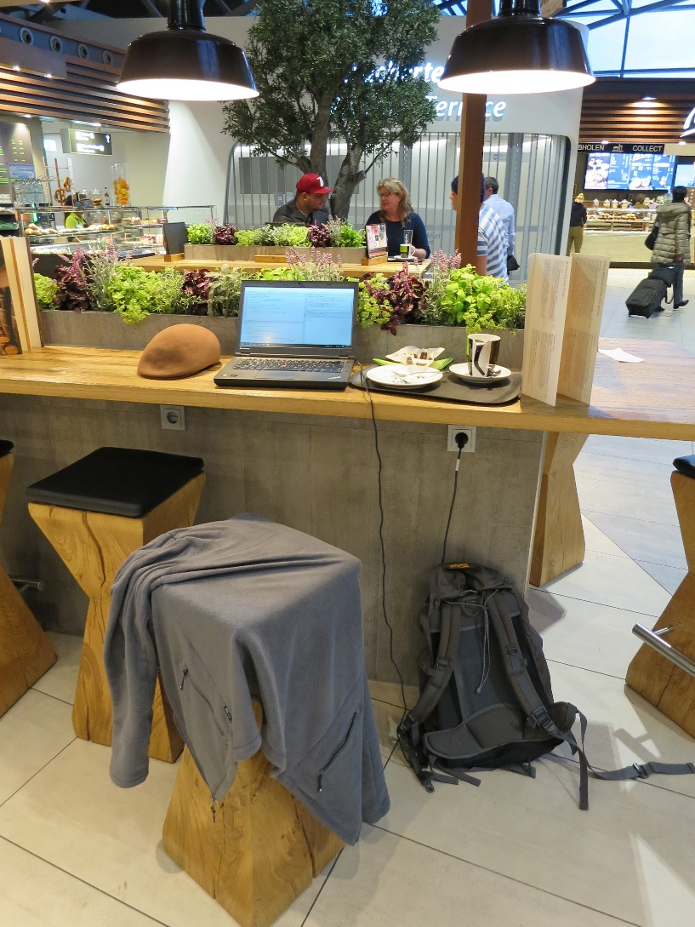
Birth of RQGIS (airport FRA)

Slide 16

Rqgis

Slide 17
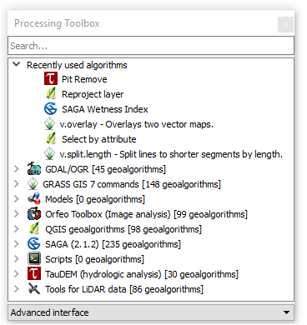
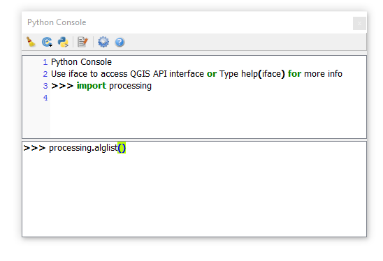
QGIS – Python API
Notes:
I think most of you are familiar with the processing toolbox of QGIS the QGIS processing toolbox from within R. These geoalgorithms can be accessed via the Python API. So I wondered if it was possible to do so also from within R.
Processing package is equivalent to the arcpy package of ArcGIS.

Slide 18




How does it work?
Notes:
Skimming through thousands of lines of Python code

Slide 19
How to use RQGIS
Download it from CRAN or github (www.github.com/jannes-m/RQGIS)

Slide 20
Most notable features of RQGIS
QGIS geoalgorithms
Access to hundreds of further geoalgorithms, especially SAGA- and GRASS-geoalgorithms
R users can stay in their environment without having to touch Python
Convenience functions open_help, get_args_man and run_qgis

Slide 21
Switch to 02_rqgis_xaringan.pdf slides for RQGIS code examples

Slide 22
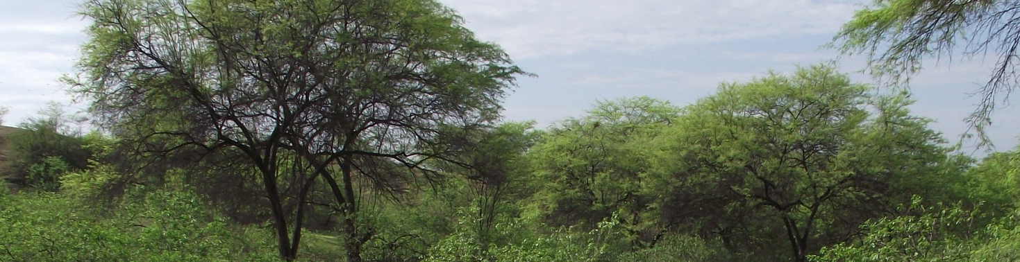
Ecological Example
Muenchow J., Bräuning A., Rodriguez E.F. & von Wehrden H. (2013): Predictive mapping of species richness and plant species‘ distributions of a Peruvian fog oasis along an altitudinal gradient. Biotropica, 45(5), 557-566. doi:10.1111/btp.12049.

Slide 23
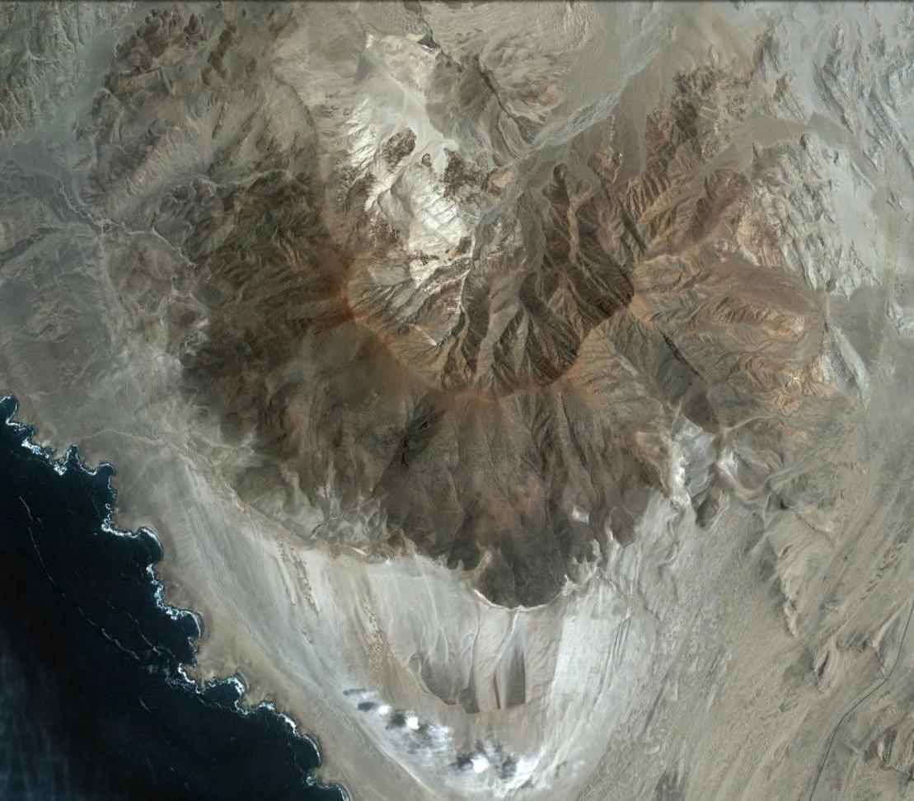
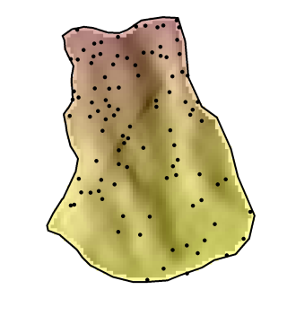
Study area – Mount Mongón
Mongón
Source: Google Earth.
Notes:
The study area is located in the Peruvian coastal desert. The mountain is called Mount Mongón and reaches an altitude of 1100 masl. I randomly sampled 100 locations/plots on the southern slope of this mountain. The plots were 4x4 meters in size and each of these plots I determined every single plant species.

Slide 24
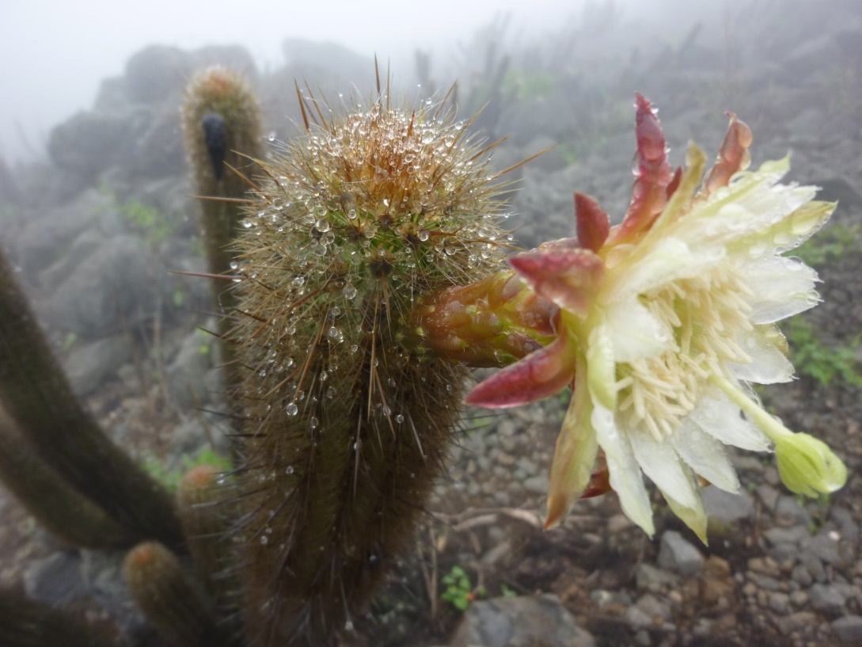
Lomas – scientific context
Highly endemic and strongly endangered vegetation formation just living of fog
Altitudinal gradient
Influence of ENSO
Spatial prediction map of species richness to delineate conservation areas
Notes:
Altitudinal gradient and relationship with predictors
Spatial prediction map to delineate conservation areas

Slide 25
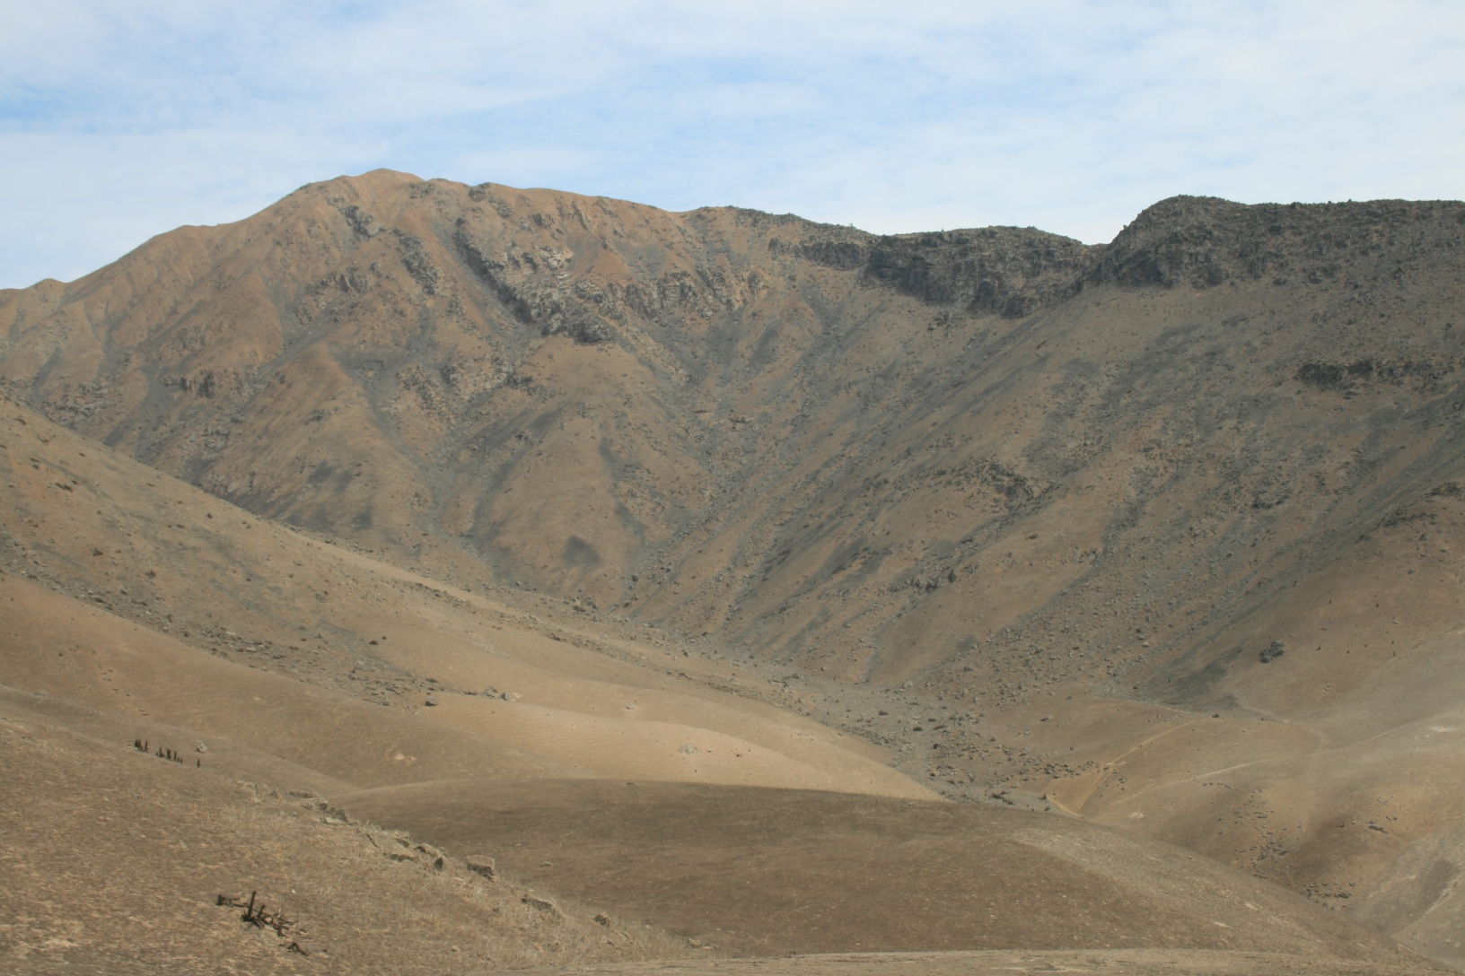
Austral summer

Slide 26

Austral winter

Slide 27
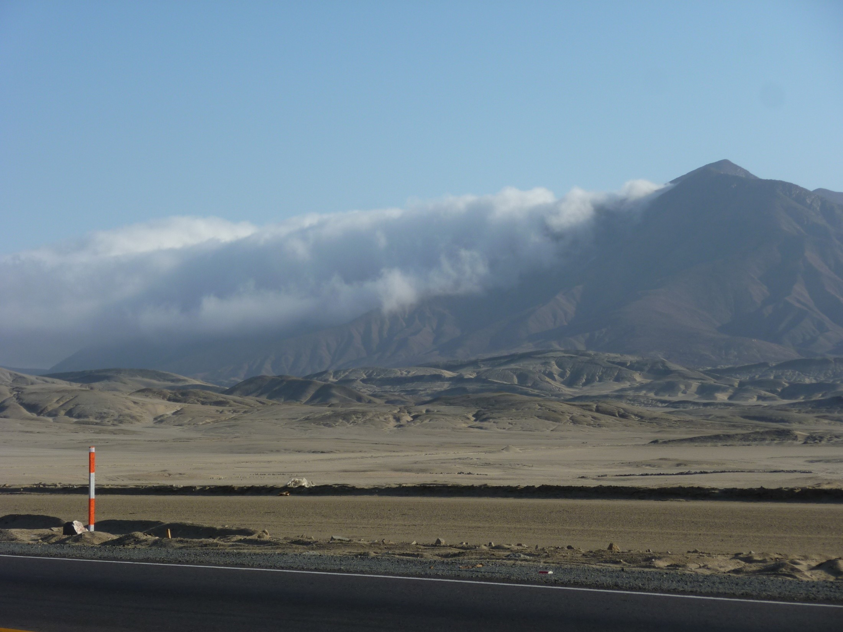

Slide 28
Non-linear Poisson model
Predictors:
Altitude
catchment slope
catchment area
SAGA wetness index
Curvatures
solar radiation
etc.
Notes:
The catchment slope output grid of the Catchment Area (Parallel) module is computed like this: for each cell, the local slope is calculated using the approach of Zevenbergen & Thorne. These slope values are accumulated downslope. Finally, for each cell the accumulated slope values are divided by the derived catchment area of the cell. The unit of the grid are radians.
I guess you can think of it as an average slope value and not the slope value at a specific location

Slide 29

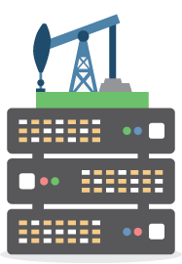
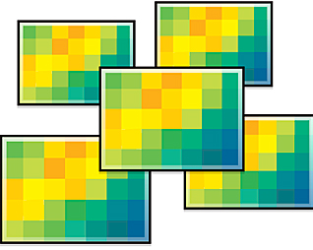
Combining the best of two worlds
http://www.esri.com/
https://7segments.com/
Notes:
QGIS (variable retrieval):
Plan and vertical curvature, SAGA wetness index, catchment slope, catchment area, NDVI
R (statistical analysis):
Variable selection, Non-linear Poisson model and spatial prediction

Slide 30
Spatial prediction of alpha diversity
Notes:
GAM, GLM and other distributions, mixed-effect models, Bayesian models, machine learning, spatial cross-validation, incorporating spatial autocorrelation and kriging techniques
But that is just one example of R-GIS integration:
Stream networks
Surface roughness
Various wetness indexes
Terrain- and landform classification
Physically-based models
LiDAR tools
Wind speed, wind direction
Routing algorithms, neighbour calculations (topology)
Computationally demanding vector operations (overlay)

Slide 32

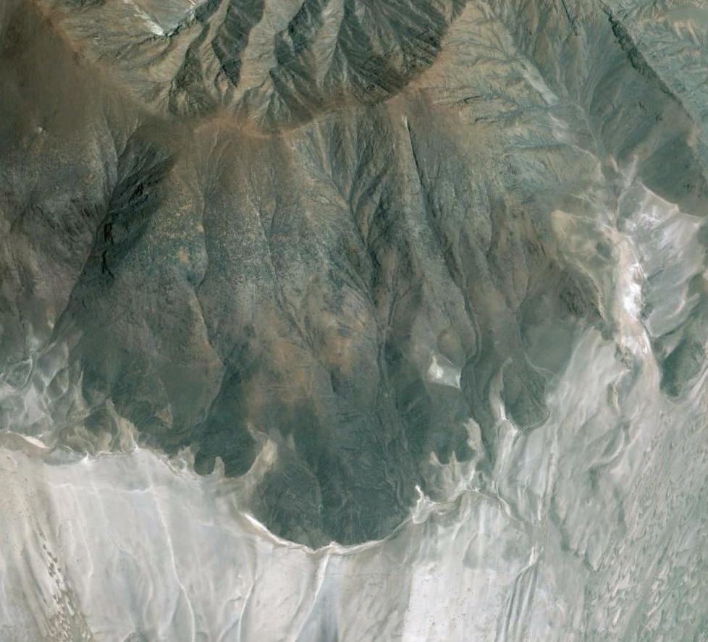
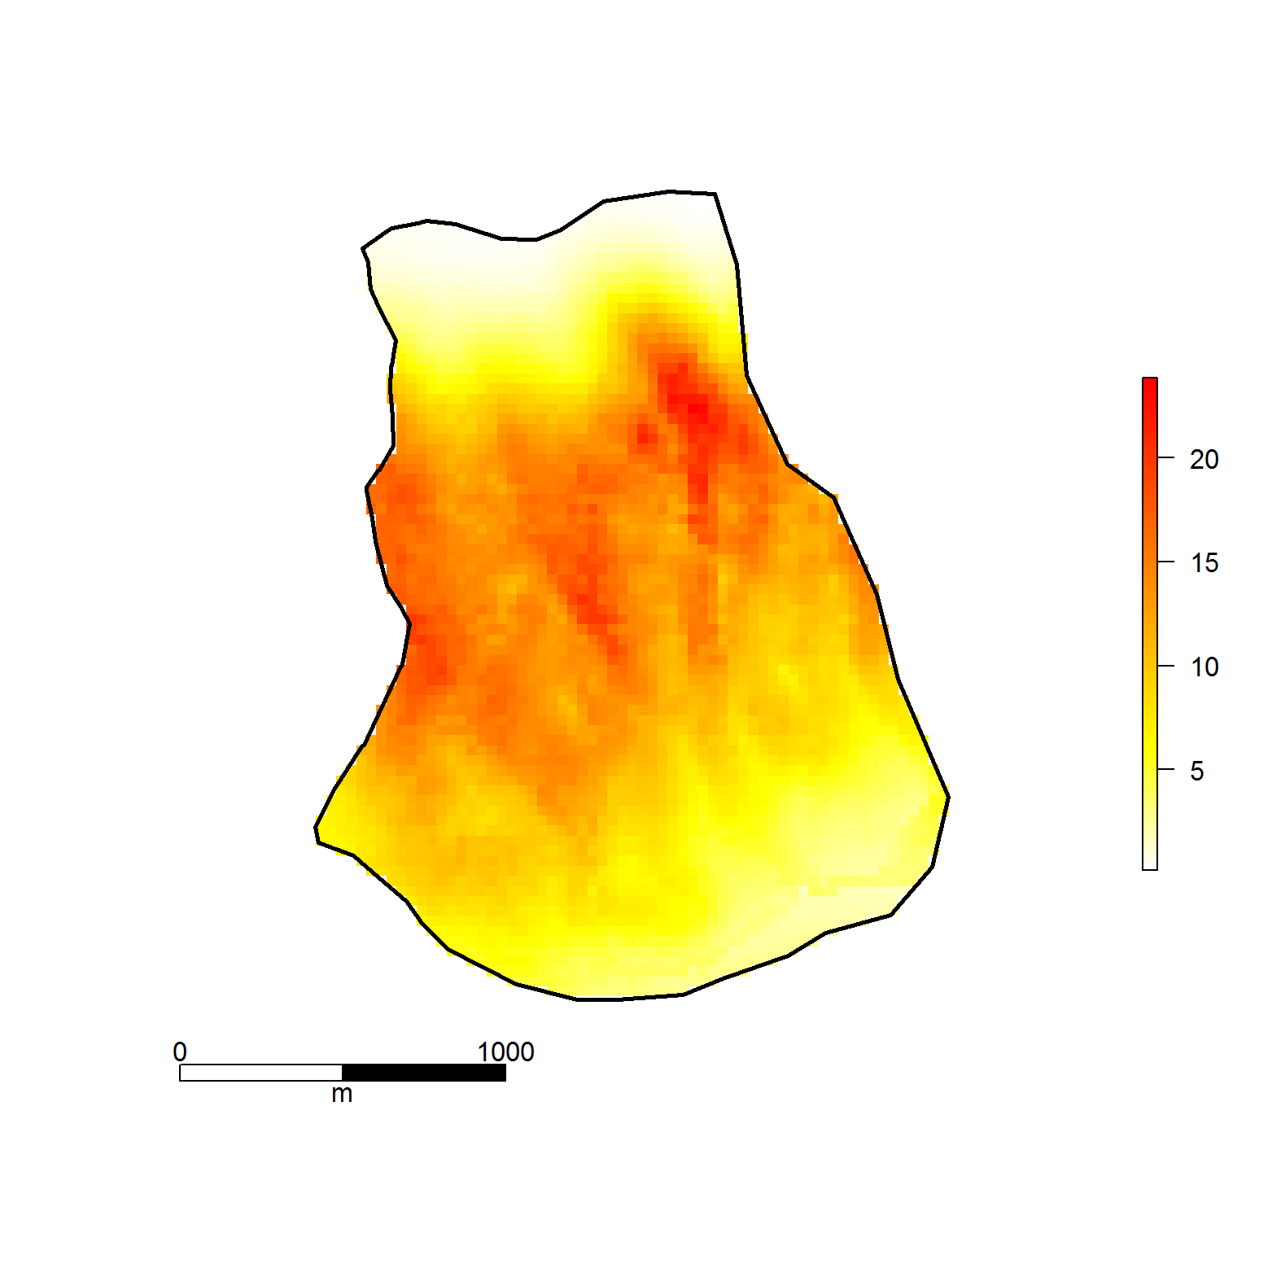
Spatial prediction of species richness (alpha diversity)
Altitude +
slope
Catchment area
NDVI

Slide 33


Discussion – R/GIS integration
Notes:
I won‘t talk much about ESRI ArcGIS and instead focus on the comparison between RQGIS and RSAGA and rgrass7

Slide 34
RQGIS vs. RSAGA/rgrass7
Unified interface to SAGA and GRASS
Interface to further 3rd-party providers
Easier-to-use
get_args_man, open_help
On-the-fly import/export of spatial objects (run_qgis)
Data conversions

Slide 35
But:
QGIS does not support the most recent SAGA versions
QGIS does not provide all SAGA and GRASS functionalities
SAGA has special geocomputing functions
Notes:
Special SAGA functions multi.local.function, grid.predict, pick.from.ascii.grids

Slide 36

Wrap-up
We can use R as a GIS
Geoprocessing is better done in a GIS
R-GIS integration combines the best of two worlds
RQGIS, RSAGA, rgrass7 are all great
collaborations
http://www.myazpiration.com/wp-content/uploads/
2014/11/Partnership-5.png
http://www.myazpiration.com/wp-content/uploads/
2014/11/Partnership-5.png
http://www.esri.com/
https://7segments.com/
Data: Rikken, M.G.J & Van Rijn, R.P.G. (1993).

